Slide 1

EXPLAIN
15 MIN
HOMEWORK REVIEW
Tell me all differences you
Observed btw PYTHON and JS

Slide 2
EXPLAIN
15 MIN
HOMEWORK REVIEW
CORRECTION / DEMO

Slide 3
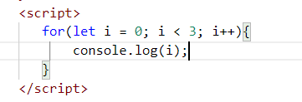
Quiz 1
What the console will display?
0123 b. 123
c. 0
1
2
d. I don’t know
Notes:
c

Slide 4
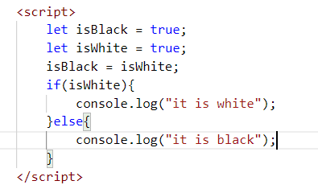
Quiz 2
What the console will display?
it is white b. it is black
c. I don’t know
d. Error
Notes:
a

Slide 5
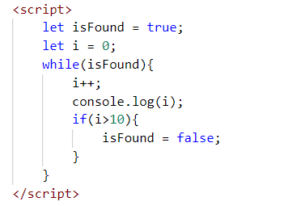
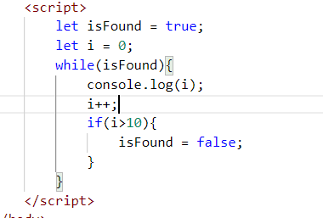
Quiz 3
Is it has the same output?
A. Yes
B. No
Notes:
b

Slide 6
Quiz 4
What the console will display?
Notes:
1-10

Slide 7
Quiz 5
Is it has the same output?
Notes:
1-11

Slide 8
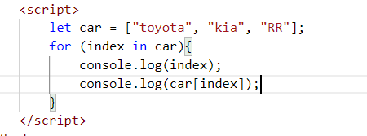
Quiz 6
What will display the value of the array car?
a. console.log(index) b. console.log(car[index])
Notes:
0
Toyota
1
Kia
2
RR

Slide 9
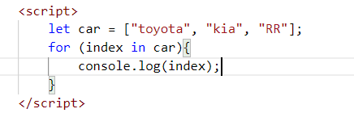
Quiz 7
What will display?
Notes:
0
1
2

Slide 10
CHAPTER 1
PYTHON to JS
PART 2
letIABLES

Slide 11
EXPLAIN
3 KIND OF LOOPS !
15 MIN
#1 - LOOP ON RANGE
1- Create
index letiable
2- Condition to
Stop the loop
3- How you increment
the index
for (let index = 0; index < 10 ; index++) {
console.log(index)
}
We loop 10 time !

Slide 12
3 KIND OF LOOPS !
#2 - LOOP ON
INDEX OF ARRAY/STRING
#3 - LOOP ON
VALUE OF ARRAY/STRING
for (let index in array) {
// DO SOMETHING
}
for (let value of array) {
// DO SOMETHING
}

Slide 13

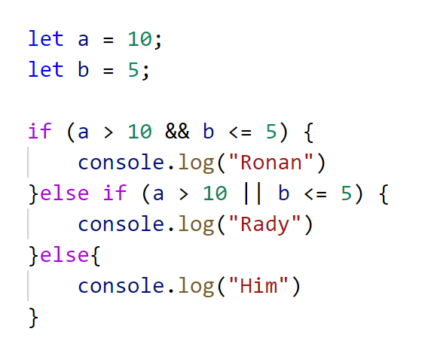
What this code will print ?
15 MIN
A.
B.
C.
D.
Ronan
Rady
HIM
Error
Notes:
b

Slide 14
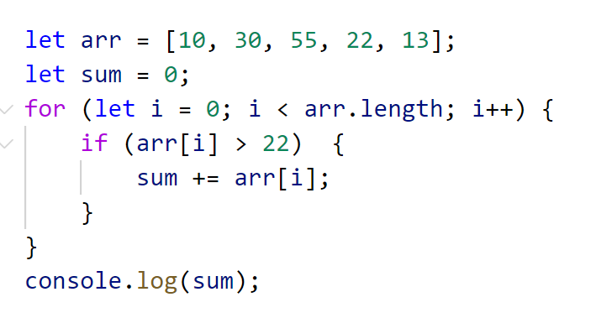
What this code will print ?
15 MIN
A.
B.
C.
D.
85
98
50
Error
Notes:
a

Slide 15
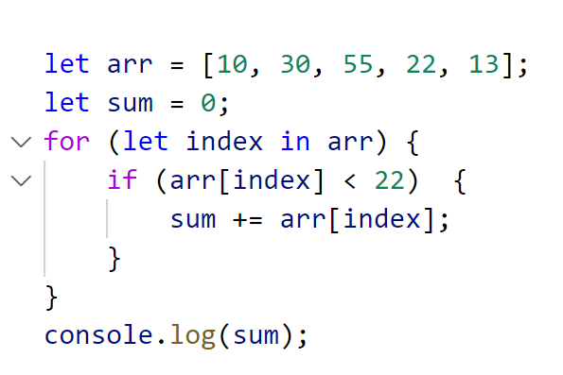
What this code will print ?
15 MIN
A.
B.
C.
D.
85
98
23
Error
Notes:
c

Slide 16
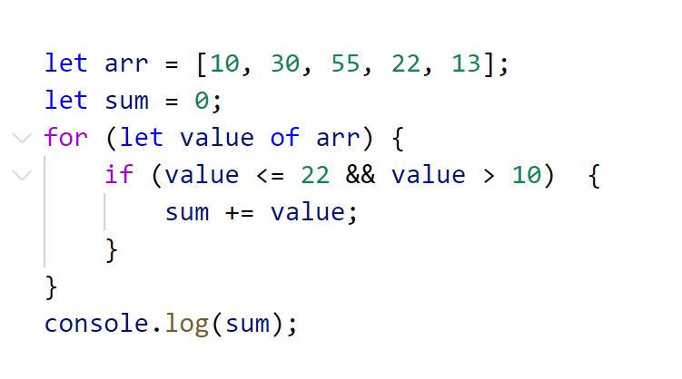
What this code will print ?
15 MIN
A.
B.
C.
D.
85
35
23
Error
Notes:
b

Slide 17
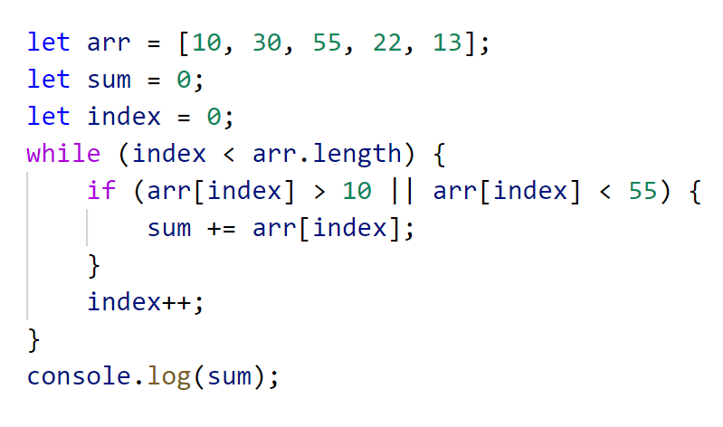
What this code will print ?
15 MIN
A.
B.
C.
D.
120
35
130
Error
Notes:
c

Slide 18
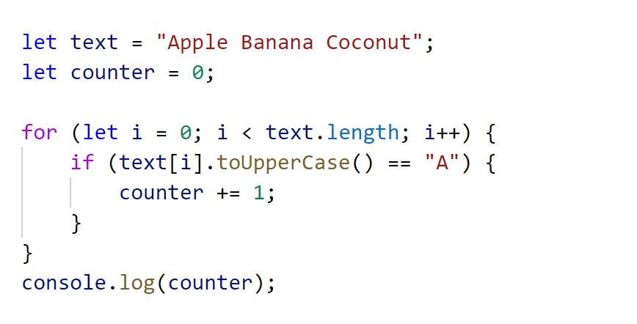
What this code will print ?
15 MIN
A.
B.
C.
D.
3
4
5
Error

Slide 19
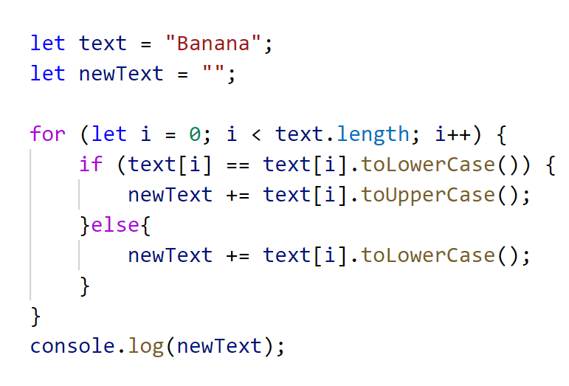
What this code will print ?
15 MIN
A.
B.
C.
D.
BANANA
Banana
bANANA
Error

Slide 20
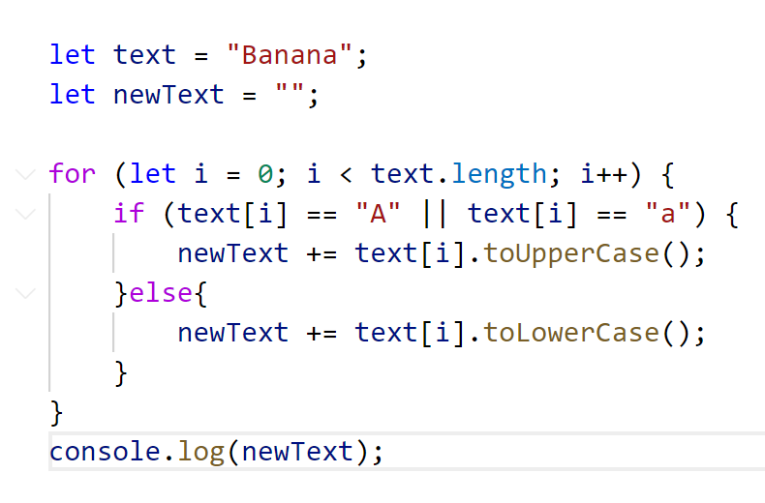
What this code will print ?
15 MIN
A.
B.
C.
D.
bAnAnA
Banana
BaNaNa
Error

Slide 21
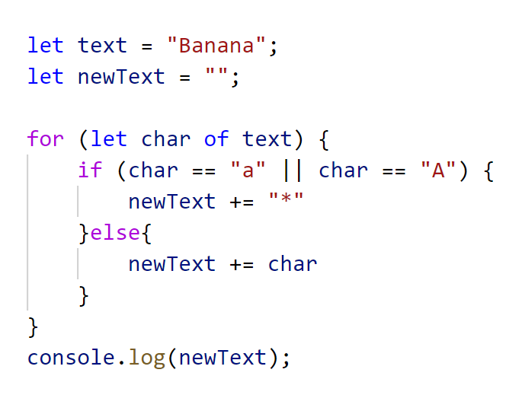
What this code will print ?
15 MIN
A.
B.
C.
D.
bAnAnA
B*n*n*
BaNaNa
Error

Slide 22
== or ===?
What this code will print ?
let fourAsNumber = 4;
let fourAsString = "4";
console.log(fourAsNumber == fourAsString);

Slide 23
EXPLAIN
== or ===?
15 MIN
What this code will print ?
let fourAsNumber = 4;
let fourAsString = "4";
console.log(fourAsNumber === fourAsString);
Yes !! 3 = !!

Slide 24
YOU SHOULD
ALWAYS
USE ===
Yes !! 3 = !!

Slide 25
ADVANCED
FEATURES
IF TIME…

Slide 26
TYPES in JS
What this code will print ?
let x = 16 + “volvo“
console.log(x)
A
B
C
D
16
16volvo
Syntax error
Runtime error

Slide 27
TYPES in JS
What this code will print ?
let x = 4 + 16 + “Volvo”
console.log(x)
A
B
C
D
20Volvo
416Volvo
Syntax error
Runtime error

Slide 28
TYPES in JS
What this code will print ?
let x = “Volvo” + 4 + 16
console.log(x)
A
B
C
D
Volvo20
Volvo416
Syntax error
Runtime error

Slide 29
Undefined variables
What this code will print ?
let carName;
console.log(carName);

Slide 30
JavaScript Block Scope
letiables declared with the let keyword can have Block Scope.
letiables declared inside a block {} cannot be accessed from outside the block.

Slide 31
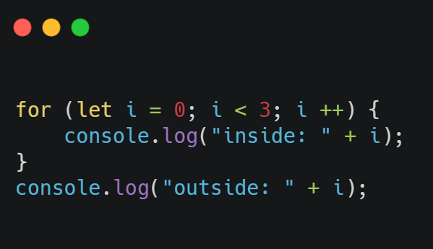
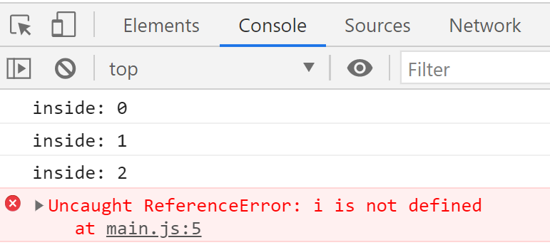
let keyword

Slide 32
LET & CONST
What this code will print ?
let x = 4
x = 5
console.log(x)
A
B
C
D
4
5
Syntax error
Runtime error
Notes:
b

Slide 33
LET & CONST
What this code will print ?
let x = 4
if (x > 3) {
let sum = 0;
sum += 5
}
console.log(sum)
A
B
C
D
4
9
Syntax error
Runtime error
Notes:
d

Slide 34
LET & CONST
What this code will print ?
let x = 7;
if (x > 4) {
let sum = 0;
sum += 5;
} else {
sum += 10;
console.log(sum)
}
A
B
C
D
Nothing
15
Syntax error
Runtime error
Notes:
a

Slide 35
LET & CONST
What this code will print ?
let x = 7;
if (x < 4) {
let sum = 0;
sum += 5;
} else {
sum += 10;
console.log(sum)
}
A
B
C
D
Nothing
15
10
Runtime error
Notes:
d

Slide 36
LET & CONST
What this code will print ?
for (let i = 0; i < 3; i++) {
let total = 0;
total += i
}
console.log(total)
A
B
C
D
Nothing
8
Syntax error
Runtime error
Notes:
d

Slide 37
LET & CONST
What this code will print ?
function text() {
let myText = "Hello Text";
return myText;
}
console.log(myText)
A
B
C
D
Nothing
Hello Text
Syntax error
Runtime error
Notes:
d

Slide 38
LET & CONST
What this code will print ?
let a = 10;
let sum = 0;
if (a < 49) {
sum += 90;
}
console.log(sum)
A
B
C
D
90
10
Syntax error
Runtime error
Notes:
a

Slide 39
const keyword
letiables defined with const behave like let letiables, except they cannot be reassigned.
Declaring a letiable with const is similar to let when it comes to Block Scope.

Slide 40
LET & CONST
What this code will print ?
const x = 4
console.log(x)
A
B
C
D
4
5
Syntax error
Runtime error
Notes:
a

Slide 41
LET & CONST
What this code will print ?
const x = 4
x = 5
console.log(x)
A
B
C
D
4
5
Syntax error
Runtime error
Notes:
d

Slide 42
LET & CONST
What this code will print ?
const a = 10;
const sum = 0;
if (a < 49) {
sum += 90;
}
console.log(sum)
A
B
C
D
0
90
Syntax error
Runtime error
Notes:
d

Slide 43
LET & CONST
What this code will print ?
const a = 10;
if (a < 49) {
const sum = 10;
}
console.log(sum)
A
B
C
D
10
45
Syntax error
Runtime error
Notes:
d

Slide 44
LET & CONST
What this code will print ?
const a = 10;
if (a < 49) {
const sum;
console.log(sum)
}
A
B
C
D
nothing
null
Syntax error
Runtime error

Slide 45
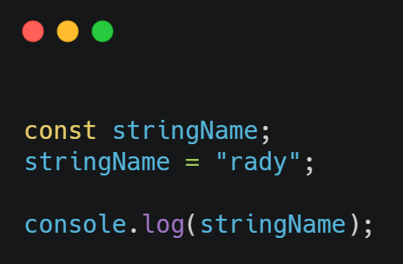
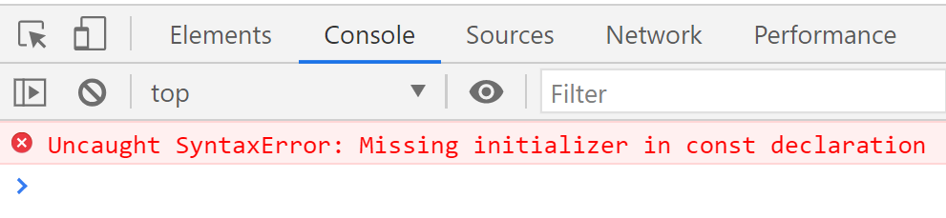
Assigned when Declared
const letiables must be assigned a value when they are declared

Slide 46
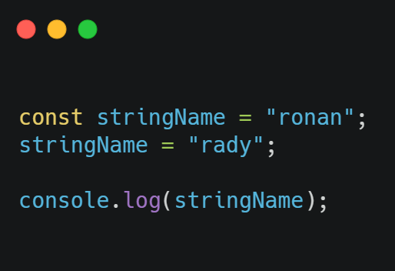
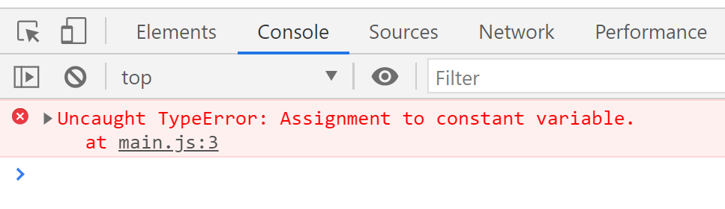
const keyword

